Slide 1
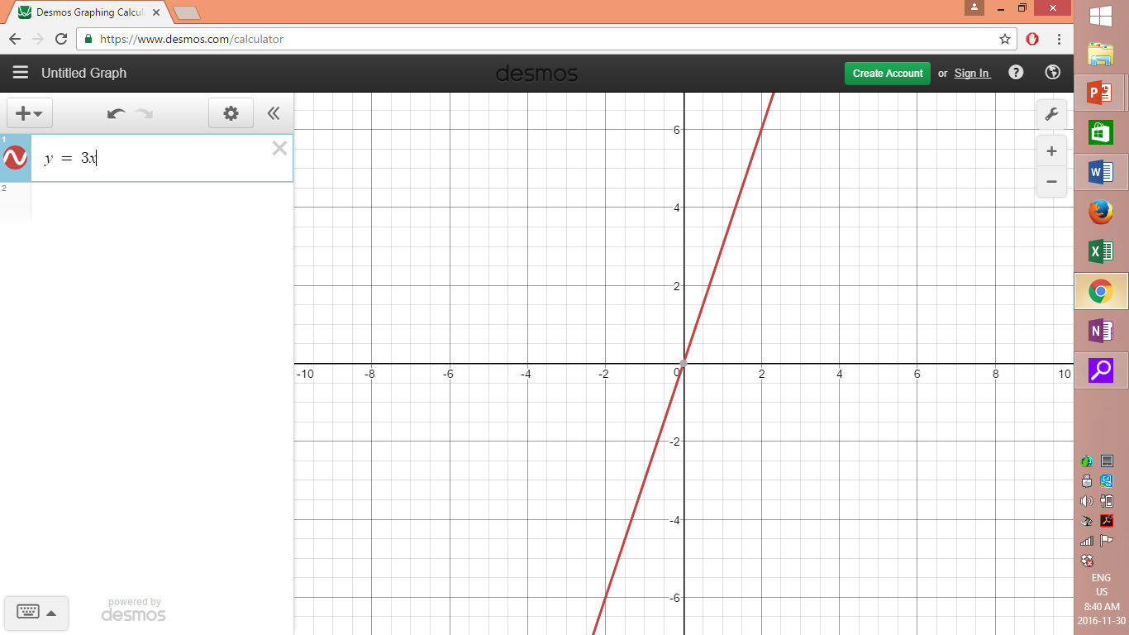
Equation: y = 3x
type of function?
Linear
Direct Variation
Increasing

Slide 2
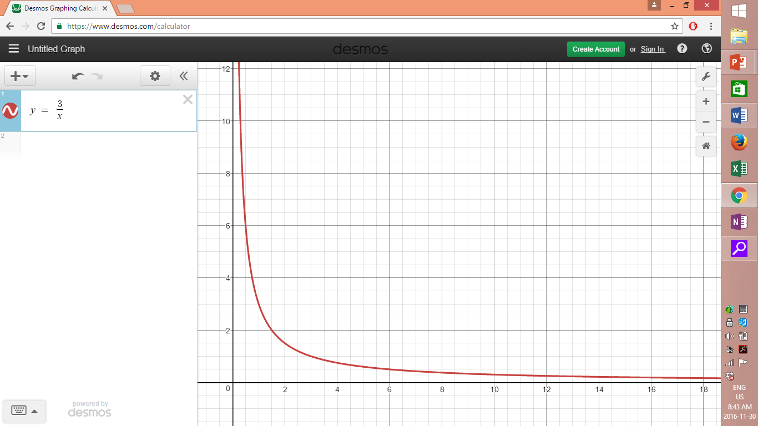
y = 3/x
Type of function?
INVERSE
Decreasing

Slide 3
Y = -2X + 1
Type of function?
Linear
Partial Variation
Decreasing

Slide 4
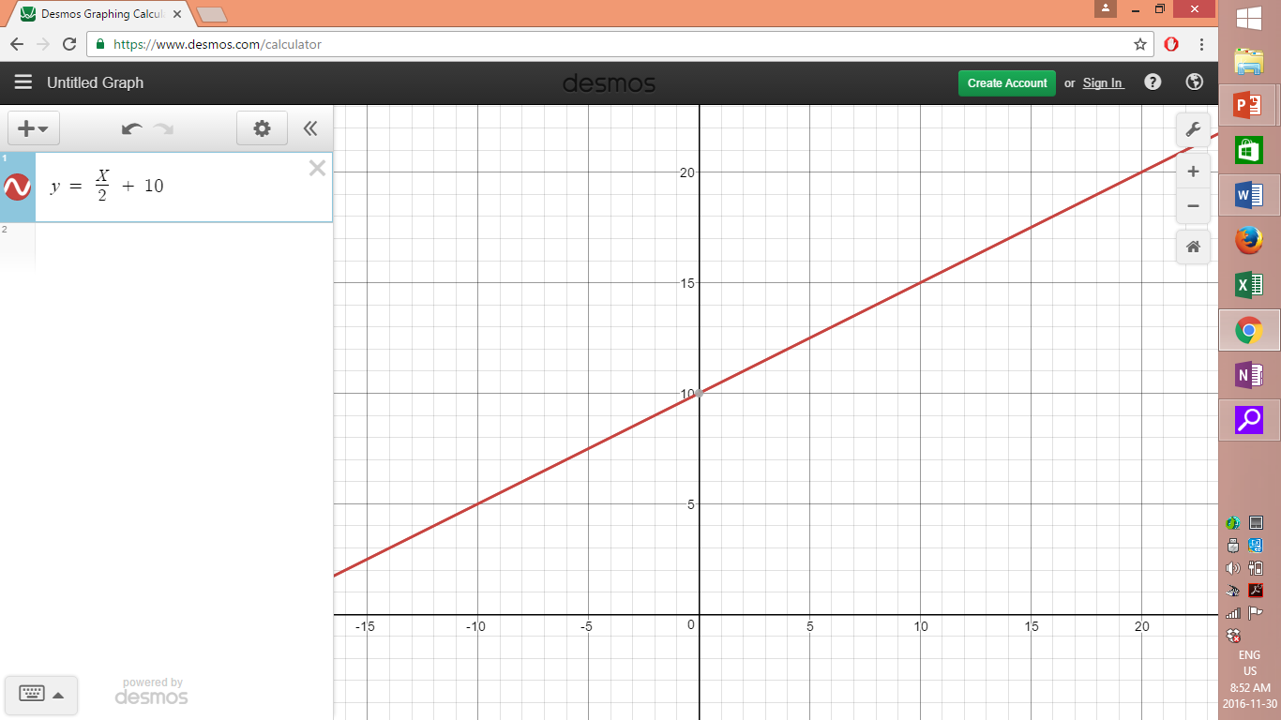
y = x/2 + 10
Type of Function?
Linear
Partial Variation
Increasing

Slide 5
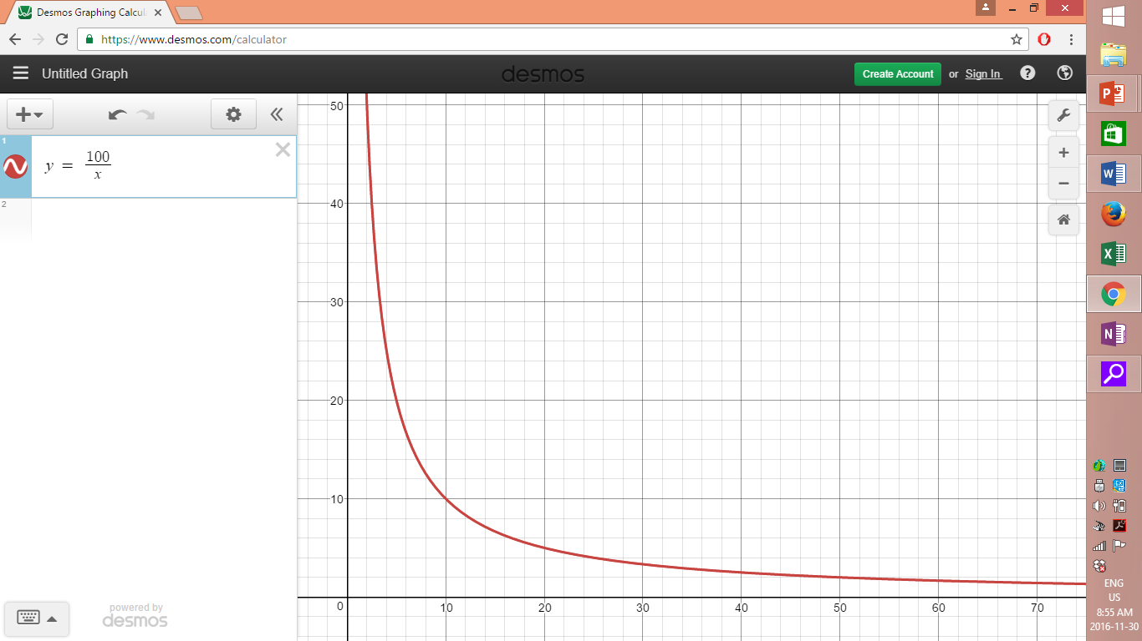
y = 100/x
Type of function?
Inverse
Decreasing

Slide 6
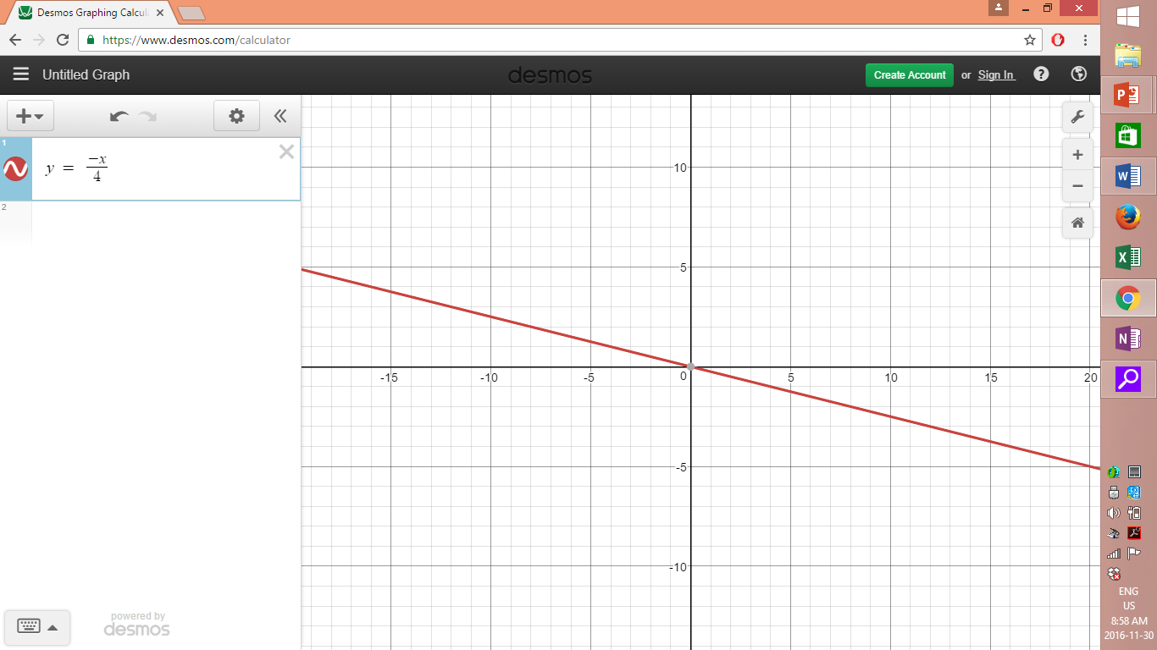
y = - x/4
What type of function?
Linear
Direct Variation
Decreasing

