Slide 1
Topics for exam:
Understanding independent vs. dependent variables
Ex: hours working vs. wage earned
Knowing the difference between an increasing and a decreasing function:
Increasing: as X increases, so does Y a linear function will have
a positive slope
Decreasing: as X increases, Y decreases
a linear function will have a
negative slope

Slide 2
Understanding how to create a linear function from a word problem:
Ex: Sally pays a $40 membership fee at the local pool and then an additional $2
each time she swims
$40 is a fixed fee or initial value
$2 each time is a ROC (slope)
the formula for her costs for swimming is: y = 2x + 40, where x = # times swimming
and y = Cost of swimming
Creating a table of values for an equation:
X 0 1 2 10
Y 40 42 44 60
Show at least two sample calculations for each equation:
Y = 2 (0) + 40 = $40
Y = 2(10) + 40
= 20 + 40 = $60

Slide 3
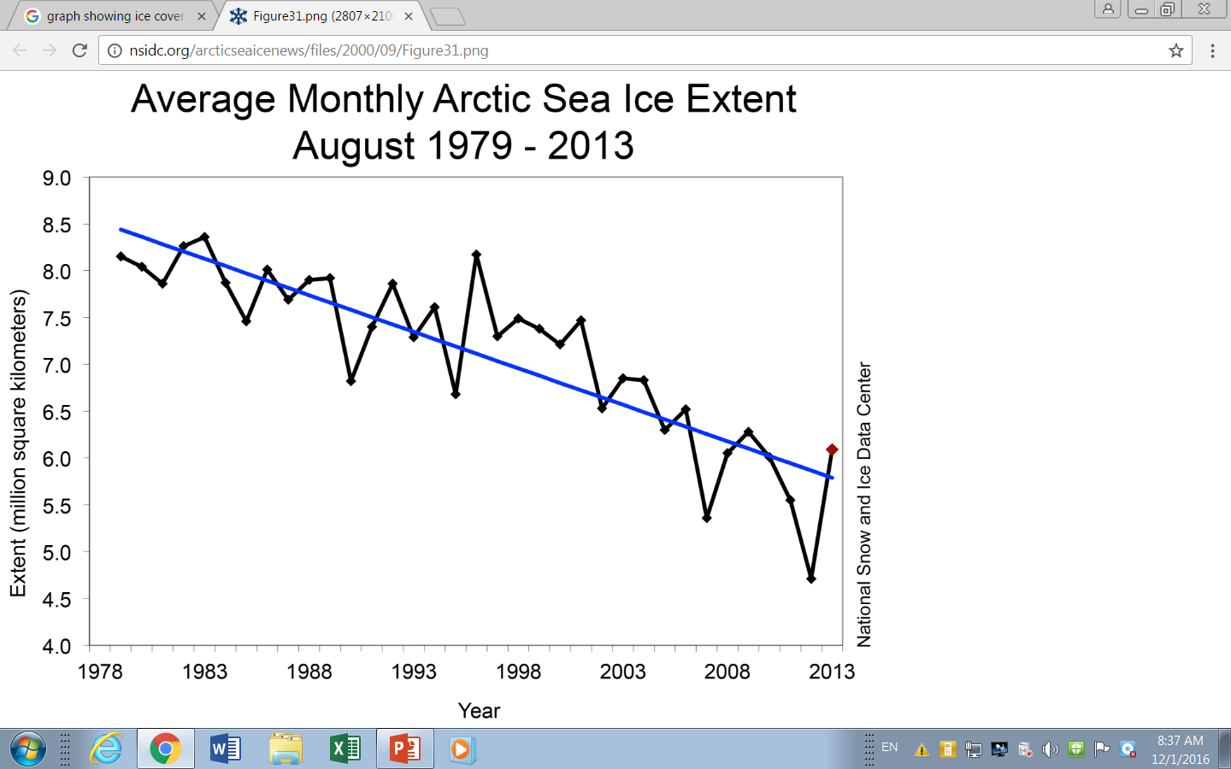
Being able to read and interpret a graph:
Blue line represents
“average” values

Slide 4
Being able to carry out simple algebraic calculations:
Adding and subtracting 5$x^{2}$ + 2 - 3$x^{2}$ - 6x - 8 – 10x (collect like terms)
5$x^{2}$ - 3$x^{2}$ - 6x – 10x + 2 – 8
2$x^{2}$ - 16x – 6
Distribution: 6x (2$x^{2}$ - 3x + 4)
= 12$x^{3}$ - 18$x^{2}$ + 24x
FOIL: (x + 3) (2x – 4) = 2$x^{2}$ - 4x + 6x – 12
= 2$x^{2}$ + 2x – 12
Division: 15$x^{4}$ + 25$x^{2}$ + 5x = 3$x^{3}$ + 5x + 1
5x
Powers of powers: 5(2$x^{2}y^{5})$⁴ = 5($2^{(1∙4)}∙x^{(2∙4)}y^{(5∙4)})$
= 5(16$x^{8}y^{20}$)
= 80$x^{8}y^{20}$ (Answer)

Slide 5
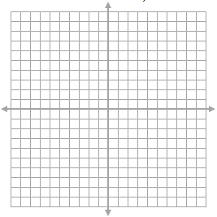
Being able to calculate the rate of change using two points:
Write formula a = y₂ - y₁
x₂ - x₁
b) Label the 2 points (-2, 4) (x₁, y₁) and (8, - 6) (x₂, y₂)
c) Substitute the coordinates into the formula:
a = - 6 – (4) = -10 = -1
8 – (-2) 10
Getting the rate of change by counting squares in the graph:
$$∆x=1$$
$$∆y=3$$
$$∆y=3$$
$∆x 1$

Slide 6

Area and perimeter formulas:
Square Rectangle Trapezoid
P = 4s P = 2L + 2W P = S₁ + S₂ + S₃ + S₄
A = $s^{2}$ A = L $∙W$ A = (B + b)h
2
Triangle Circle
P = S₁ + S₂ + S₃ C = 2$πr$
A = b$∙h$ A = 𝛑${ r}^{2}$
2
x

Slide 7

L = x + 2
W = 2x – 2
A = (x + 2) (2x – 2)
= 2$x^{2} −2x+4x −4$
= 2$x^{2}+2x −4$
P = 2L + 2W
= 2(x + 2) + 2(2x – 2)
= 2x + 4 + 4x – 4
= 6x
If the perimeter is 18, then you can solve for x
6x = 18
6(3) = 18
x = 3
Find the area:
A = 2$x^{2}+2x −4$
= 2${(3)}^{2}+2(3) −4$
= 2$∙9+6 −4$
= 18 + 6 – 4
= 20$u^{2}$

