Slide 1
MEASURES OF CENTRAL TENDENCY

Slide 2
THE MEAN
-
x
-
x = sum of data
number of data
Ex: 1,5,10,15,25
-
x = 1+5+10+15+25
5
x = 56
5
-
x = 11.2
-

Slide 3
Data with Frequencies
-
Value (x) | Frequency (F) | F x
1 | 1 | 1
2 | 3 | 6
3 | 2 | 6
4 | 2 | 8
5 | 1 | 5
Σ F = 9 Σ Fx = 26
-
Σ Fx
x = SUM OF (Fx)
SUM OF F
Σ F
Σ means SUM OF
use this to show the totals of the columns
-
x = 26
9
-
x = 2.89

Slide 4
THE MODE Mo
The mode is the value that occurs most frequently.
Not Grouped Data (or Ungrouped)
Ex: 3,7,7,8,8,9,9,10,11,15,15,15
Mode is: 15

Slide 5
Grouped Data
What is the mode?
Age | F
12 | 25
13 | 22
14 | 30
15 | 30
16 | 29
This distribution is called “bimodal” – meaning there are two modes: 14 and 15.
Ex:
The “modal class” is the class with the highest frequency.
Another example:
Age | F
[10-15[ | 3
[15-20[ | 7
[20-25[ | 9
[25-30[ | 4
The class with the highest frequency is [20-25[. It is called the “Modal class.”

Slide 6
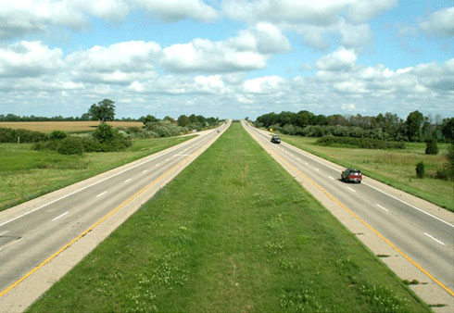
THE MEDIAN Md
Median separates an ordered set of data. (#’s go from smallest to greatest)
MEDIAN
Example: 1,2,3,6,10,11,14
MEDIAN
Example: 1,2,3, 6 ,10,11,14
3 numbers on each side of the 6

Slide 7
To find the median you must put the data in ascending order first.
Odd # of Data
Even # of Data
Example: 2,3,4,4,5,6,9
Example: 2,3,4,5,6,6,7,8
There are 7 numbers
7/2 = 3.5
Round UP to 4th number
It will be the 4th number from the beginning
When you have an even # of data, the median # is the average of the 2 middle numbers.
8/2 = 4
4th and 5th numbers
2
5+6
2
Md = 5.5
Md = 4
When you have an odd # of data, the median WILL BE one of the data items.

