Slide 1
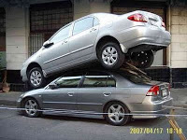
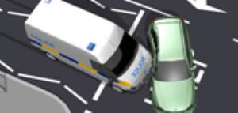
Page 72, #12
Braking distance under different road conditions:
Wet road Dry road
d(s) = 0.007s² + 0.008s
d(s) = a۰s²
50 = a ۰(100)²
a = 50/(10 000) = 0.005
d(s) = 0.005s²
b) d(90) = 0.007(90)² + 0.008(90)
= 0.007(8100) + 0.72
= 56.7 + 0.72
= 57.42m
c) d(60) = 0.005 (60)²
d(60) = 0.005(3600)
= 18m
d) d(80) = 0.007s² + 0.008s
= 0.007(80)² + 0.008(80)
= 45.44s
d(80) = 0.005(80)²
= 0.005(6400)
= 32m

Slide 2
Page 74, #19
Experienced
610m = 3660 – 4.9t²
610 – 3660 = -4.9t²
-3050 = -4.9t²
-3050/(-4.9) = t² = 622.45
t = √(622.45) = 24.95s
Beginners
1070m = 3660 – 4.9t²
1070 – 3660 = -4.9t²
-2590 = -4.9t²
-2590/-4.9 = t² =528.57
t = √(528.57) = 23s

