Slide 1
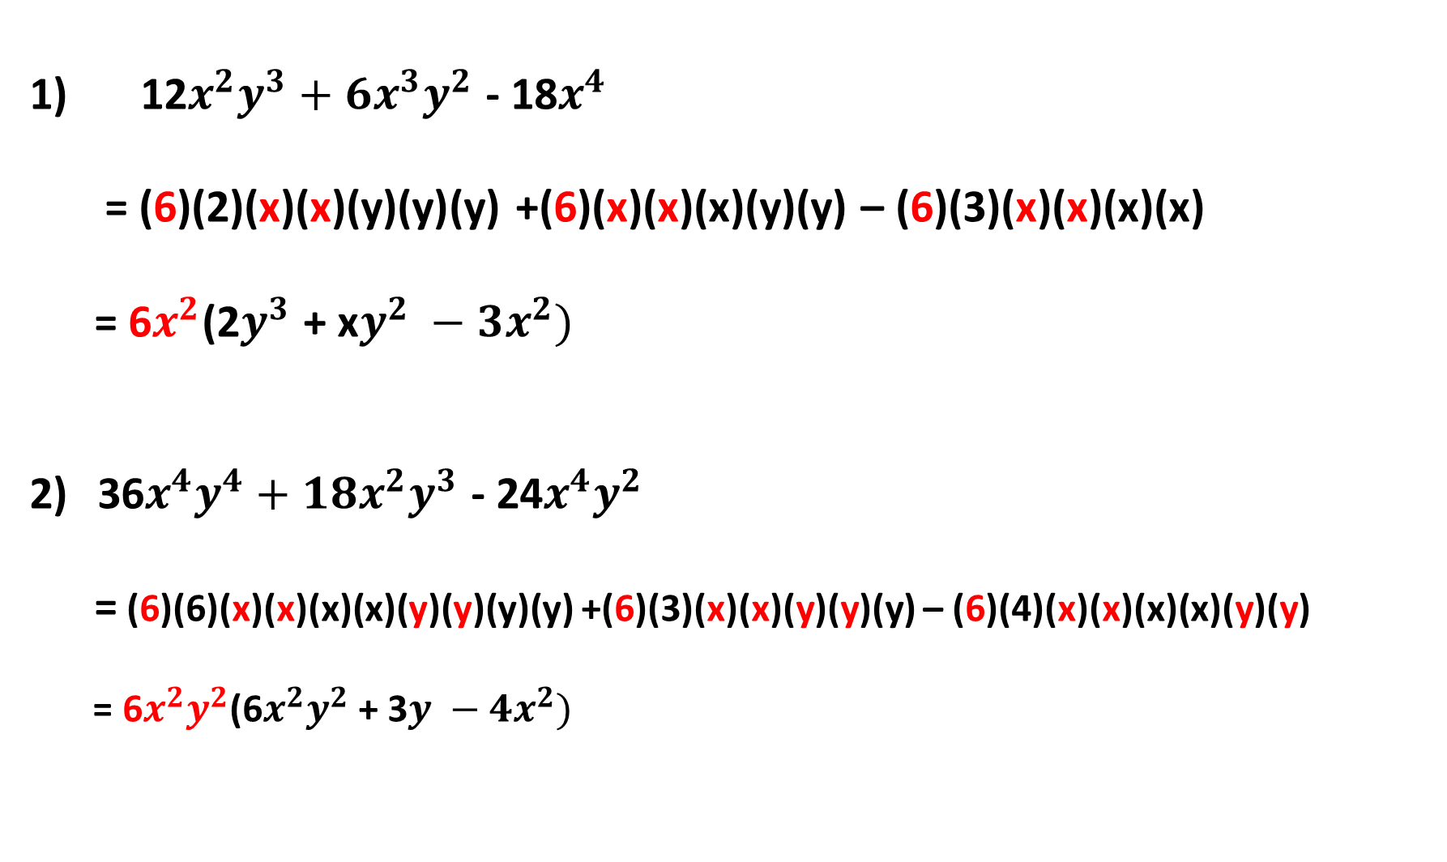
12$x^{2}y^{3}+6x^{3}y^{2}$ - 18$x^{4}$
= (6)(2)(x)(x)(y)(y)(y) +(6)(x)(x)(x)(y)(y) – (6)(3)(x)(x)(x)(x)
= 6$x^{2}$(2$y^{3}$ + x$y^{2} −3x^{2})$
36$x^{4}y^{4}+18x^{2}y^{3}$ - 24$x^{4}y^{2}$
= (6)(6)(x)(x)(x)(x)(y)(y)(y)(y) +(6)(3)(x)(x)(y)(y)(y) – (6)(4)(x)(x)(x)(x)(y)(y)
= 6$x^{2}y^{2}$(6$x^{2}y^{2}$ + 3$y −4x^{2})$

Slide 2
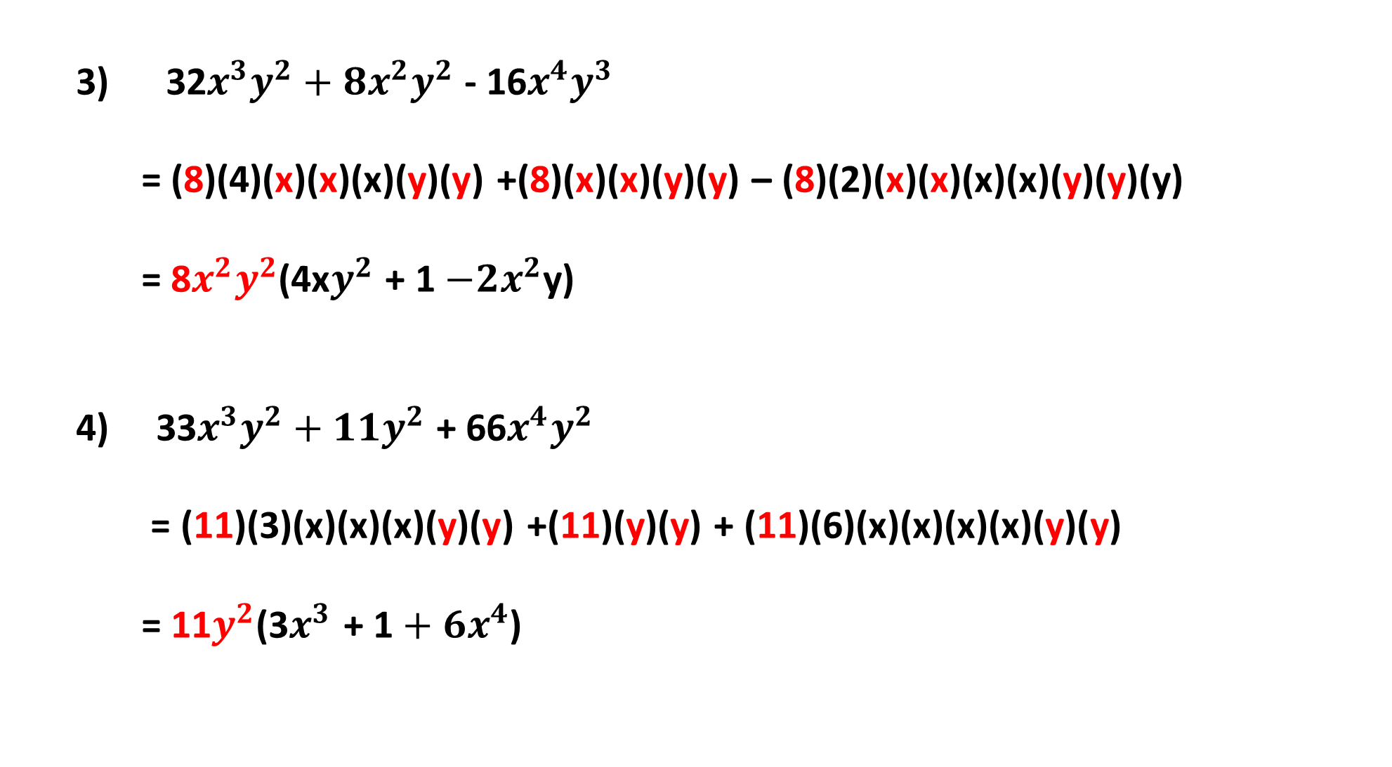
3) 32$x^{3}y^{2}+8x^{2}y^{2}$ - 16$x^{4}y^{3}$
= (8)(4)(x)(x)(x)(y)(y) +(8)(x)(x)(y)(y) – (8)(2)(x)(x)(x)(x)(y)(y)(y)
= 8$x^{2}y^{2}$(4x$y^{2}$ + 1$−2x^{2}$y)
4) 33$x^{3}y^{2}+11y^{2}$ + 66$x^{4}y^{2}$
= (11)(3)(x)(x)(x)(y)(y) +(11)(y)(y) + (11)(6)(x)(x)(x)(x)(y)(y)
= 11$y^{2}$(3$x^{3}$ + 1$+ 6x^{4}$)

Slide 3
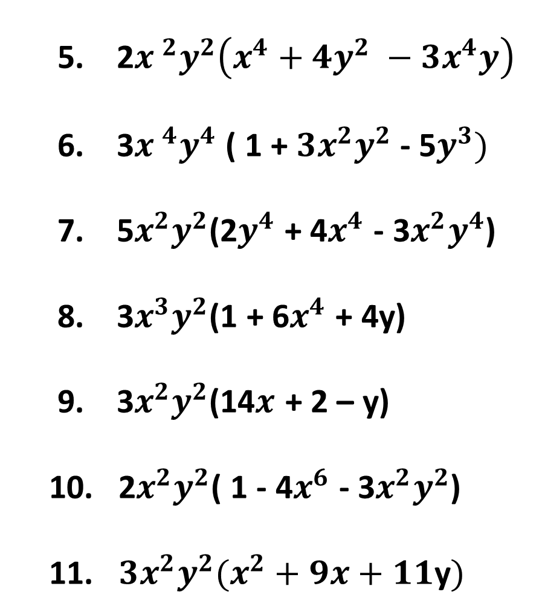
5. 2${x }^{2}y^{2}\left(x^{4}+4y^{2} −3x^{4}y\right)$
6. 3${x }^{4}y^{4}$ ( 1 +$3x^{2}y^{2}$ - 5$y^{3})$
7. 5$x^{2}y^{2}$(2$y^{4}$ + 4$x^{4}$ - 3$x^{2}y^{4}$)
8. 3$x^{3}y^{2}$(1 + 6$x^{4}$ + 4y)
9. 3$x^{2}y^{2}$(14$x$ + 2 – y)
10. 2$x^{2}y^{2}$( 1 - 4$x^{6}$ - 3$x^{2}y^{2}$)
11. ${3x}^{2}y^{2}(x^{2}+9x+11\text{y})$
12. $x^{2}y^{2}(y −1 −16xy)$
13. 11$x^{2}y^{2}$(2 – x - 6$x^{2}y$)

