Slide 1
Dividing
Polynomials

Slide 2
Monomial ÷ Monomial
10x ÷ 2
* Check your answer *
2(5x) =
10x
x
5
Final Answer:
5x

Slide 3
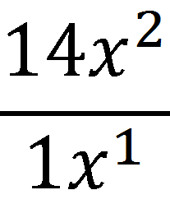
Examples
6x³ ÷ 2x²
3
x
14
x
Final Answer: 14x
Final Answer: 3x

Slide 4
Binomial ÷ Monomial
(8a³ + 7a²) ÷ 1a
Remember your
Exponents rules!
*When you divide
like bases, you
SUBTRACT the
Exponents!! *
8a²
7a
Final Answer: 8a² + 7a

Slide 5
Example
(6m⁴ – 12m³) ÷ 3m
2m³
-4m²
Final Answer: 2m³ – 4m²

Slide 6
Trinomial ÷ Monomial
(6x² + 4x +2) ÷ 2
Check your answer
(3x² + 2x + 1)(2)
= 6x² + 4x + 2
3x²
2x
1
Final Answer: 3x² + 2x + 1

Slide 7
Examples
(25x³ + 15x² + 10x)
(a⁴ + a³ + a) ÷ a
5x
5x²
3x
2
a³
a²
1
Final Answer: 5x²+3x+2
Final Answer:
a³ + a² + 1

Slide 8
WORKBOOK
Practice ☺
p.52 - Activity 3
p.53 - #5, #7e
p.56 - #9
p.58 - #3
p.65 - #36, 37, 38
…then…
p.60 - #14, 15, 16
p.61 - #20

