Slide 1
ALGEBRA
Algebra is a branch of mathematics in which symbols are used to represent numbers

Slide 2
Symbols
symbols used in algebra are called letters
a symbol used to represent a number is called a
variable
What is an algebraic expression ???
It is an expression made up of one or more terms

Slide 3
All about TERMS…
a number (constant)
a variable
a number • a variable
A term could be:
Examples of Terms
32 45 Constant (a number all alone)
d y Variable (a letter all alone)
6n 4f Number multiplied by a variable
6 and 4 are called the
Coefficients

Slide 4
How many terms can you count?
2a + 4
3 – 7c + 2c – 3
6a + 4c – 3v
2 terms
1 term
3 terms
Don’t forget to simplify completely before deciding how many terms there are.

Slide 5
“Like Terms”
A LIKE term is when IDENTICAL exponents are assigned to IDENTICAL variables.
Examples: 2a² 4a² -19a² variables are all ‘a’
exponents are all ‘2’
Important: The coefficient is ignored when
determining if terms are “LIKE”

Slide 6
Monomials → r², 4c, -9s A single term not linked by addition or subtraction. Monomials have non-negative integer exponents.
P O L Y N O M I A L S
Binomials→ 3a + 5
a² – 4
Trinomials → a² + 4x – 23
7b³ – 6x² + 2
Two monomials linked by addition or subtraction. The two terms may not be LIKE terms.
Three monomials linked by addition or subtraction. The three terms may not be LIKE terms.
Binomials & Trinomials are made up of
monomials that are not “LIKE”

Slide 7
So..who uses algebra anyway???
Fighter Pilots …

Slide 8
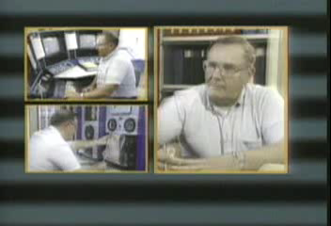
A weatherman…

Slide 9
Practice adding / subtracting polynomials
8x³
6x³+ 2x³ =
8c³d +4a²b³– 5c³d - 10a²b³ =
3c³d
- 6a²b³
When you add or subtract LIKE terms, you ONLY work with the coefficient

Slide 10
Practice :
Textbook
Textbook
Page 252 # l(at top)
Activity 1 a)
Page 253 b)
c)
Page 256 #1
#2
Page 257 #5
#9
page 262 #1-4
Page 263 #5-7 9-11

