Slide 1
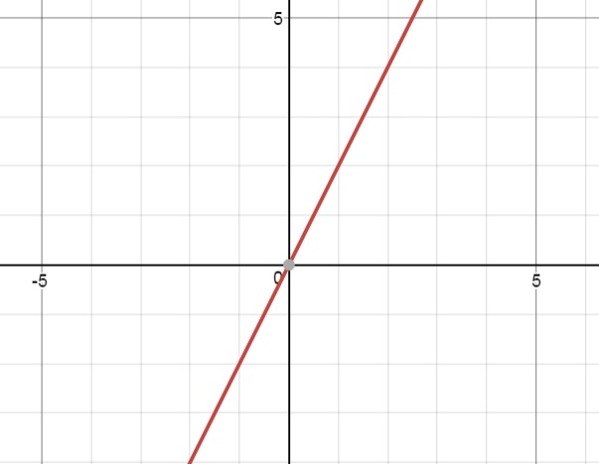
Change in x = + 1
Change in y = +2
a = Change in y = +2 = 2
Change in x +1
Equation of the line :
y = 2x
Passes through
(0, 0), so b= 0

Slide 2
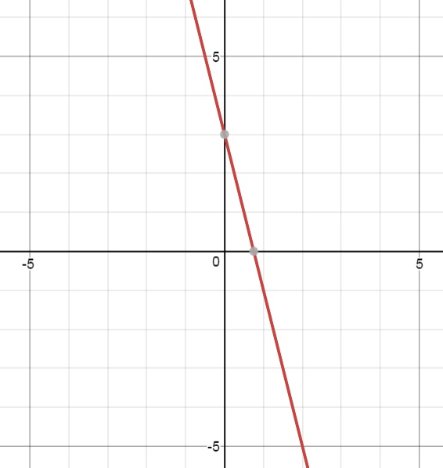
a= Change in y = -4 = -4
Change in x +1
y = ax + b
Y = -4x + 3
The initial value:
(0, b) = (0, 3)
Change in y = -4
Change in x = +1

Slide 3
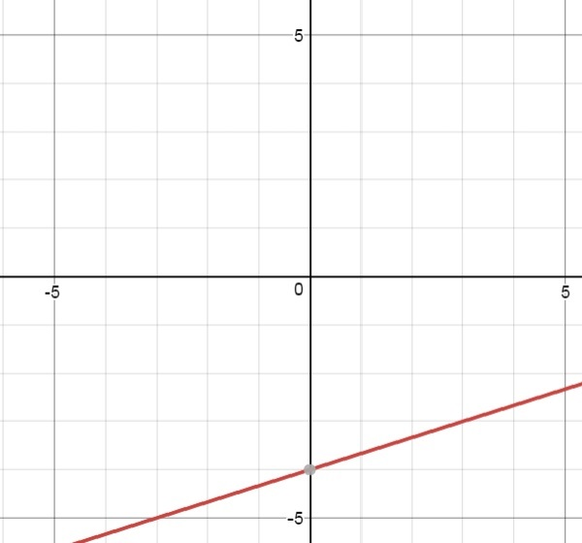
Change in y = +1 = 1 =a
Change in x +3 3
y = ax + b
y = x - 4
3
The initial value is (0, b) = (0, -4)
Change in x = +3
Change in y = +1

Slide 4
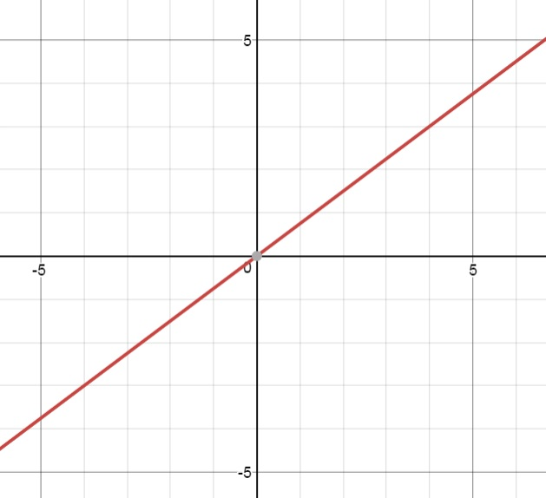
Change in x = +4
Change in y = +3
Initial value =
(0, b) = (0, 0)
a = Change in y = +3 = 3
Change in x +4 4
y = ax + b
y = 3x
4

