Slide 1
Worksheet A factoring
7) uv(2 + 5$u^{5}$) 8) 2(3$m^{2}n^{6}$ + 5)
9) -$x^{2}y^{1}(5x^{2}+2y^{2})$ 10) 2$b^{3}$(2$b^{3}a^{4} −3)$

Slide 2
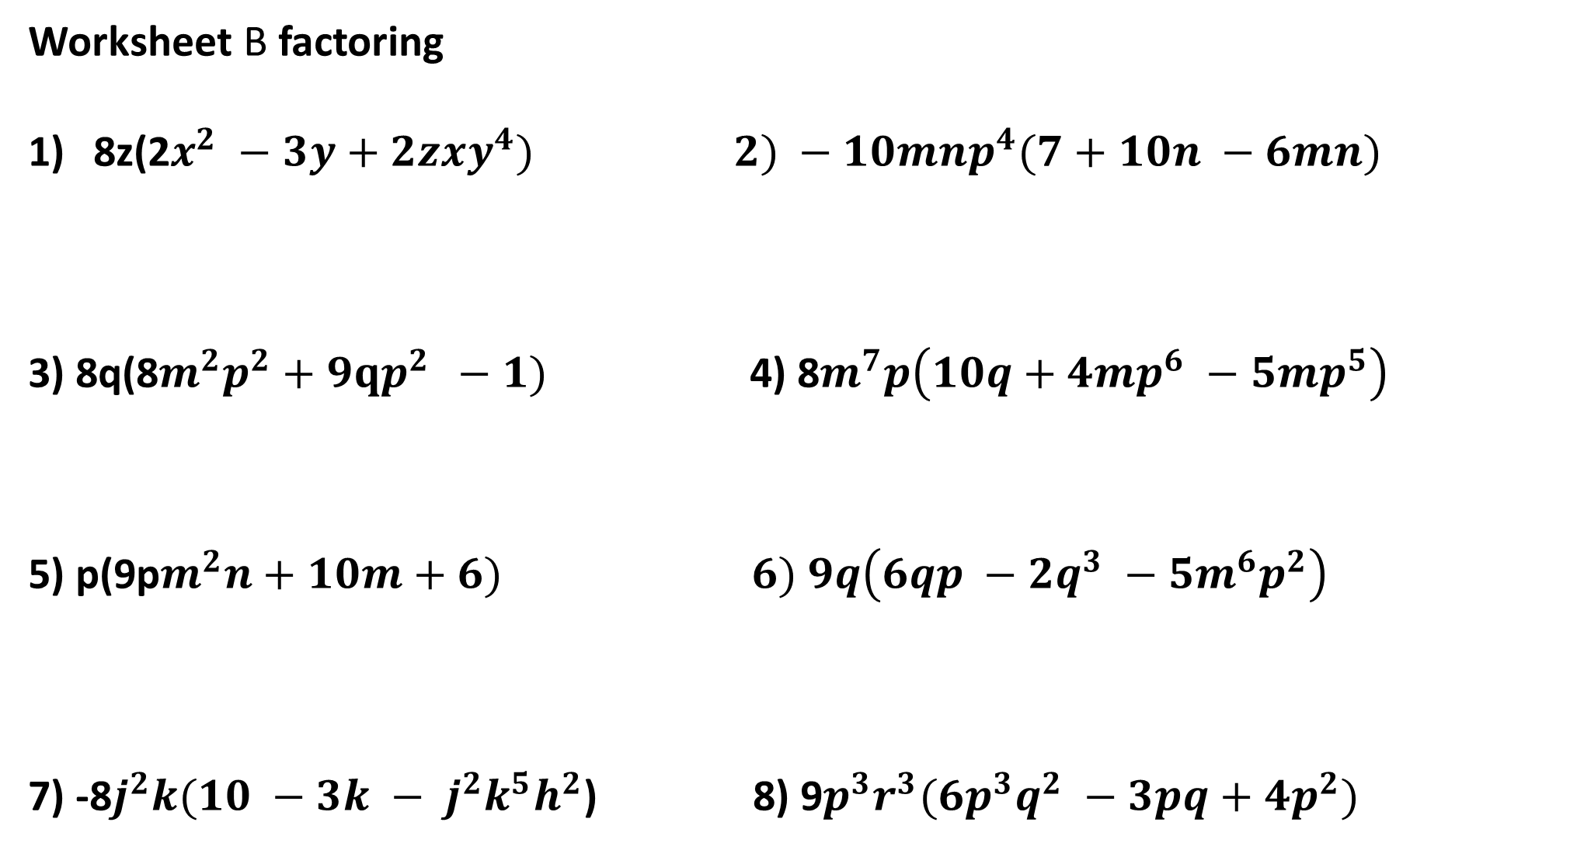
Worksheet B factoring
8z(2$x^{2} −3y+2zxy^{4}) 2) −10mnp^{4}(7+10n −6mn)$
3) 8q(8$m^{2}p^{2}+9qp^{2 } −1)$ 4) 8$m^{7}p\left(10q+4mp^{6} −5mp^{5}\right)$
5) p(9p$m^{2}n+10m+6) 6) 9q\left(6qp −2q^{3} −5m^{6}p^{2}\right)$
7) -8$j^{2}k(10 −3k − j^{2}k^{5}h^{2}$) 8) 9$p^{3}r^{3}(6p^{3}q^{2} −3pq+4p^{2})$

